Slide 1
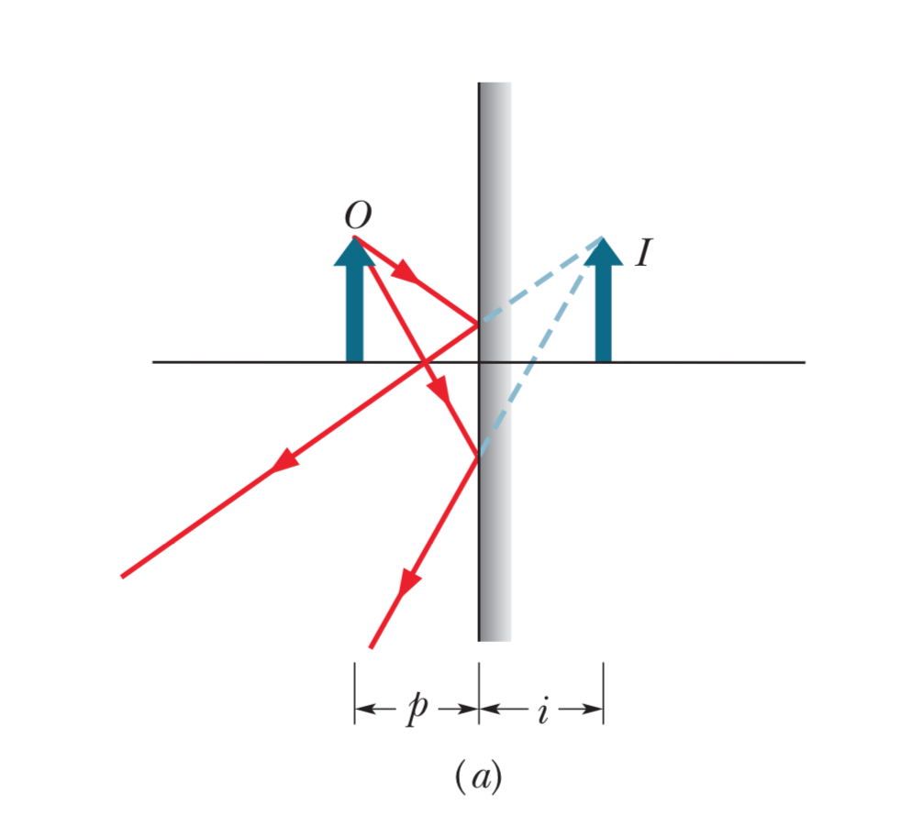
Review of Last Time
Plane mirror, physical distance, and image distance

Slide 2
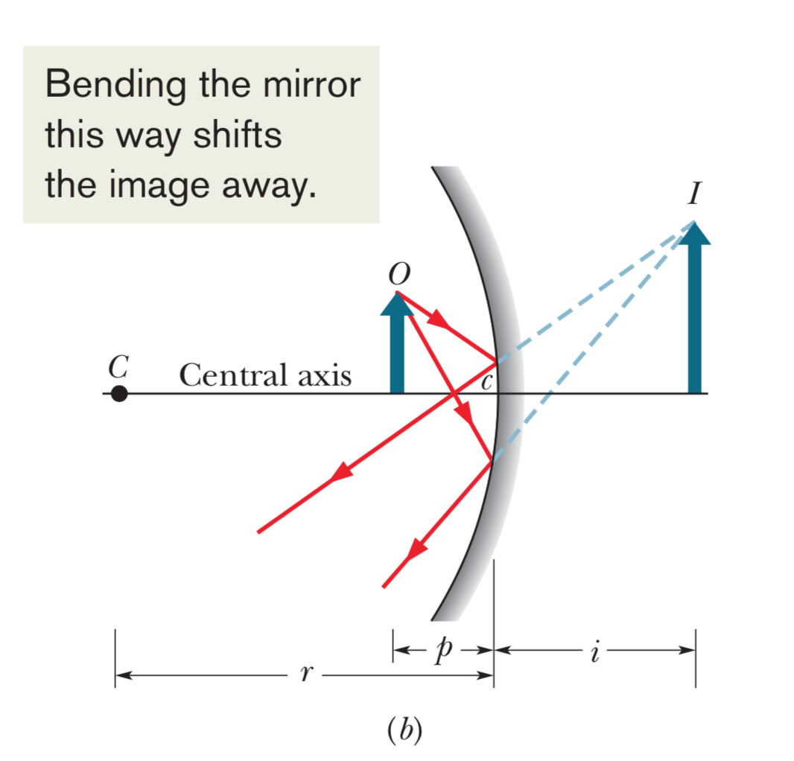
Concave spherical mirror

Slide 3
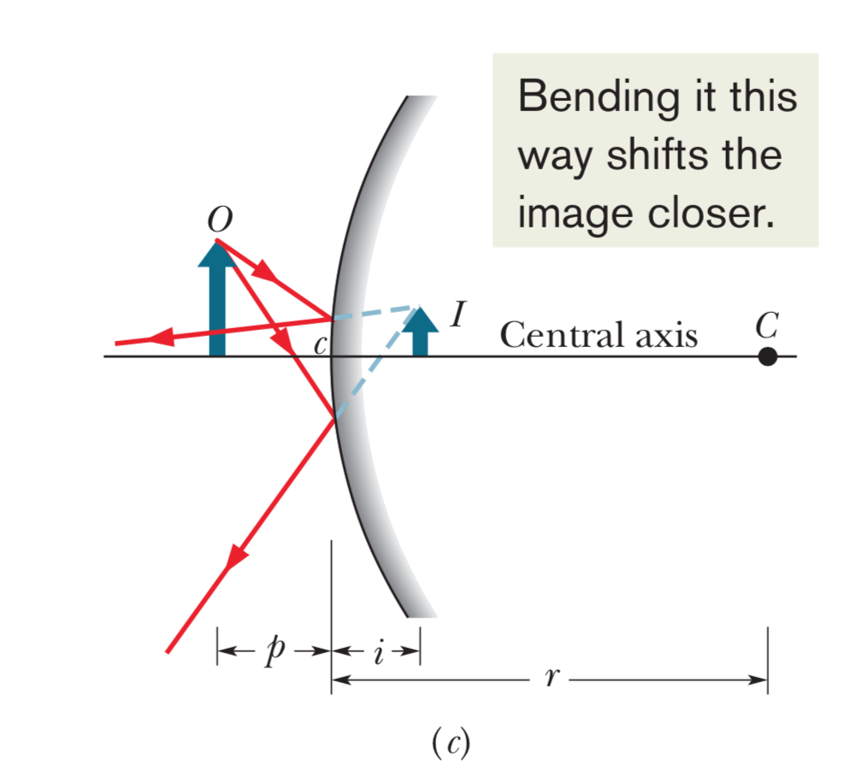
Convex spherical mirror

Slide 4
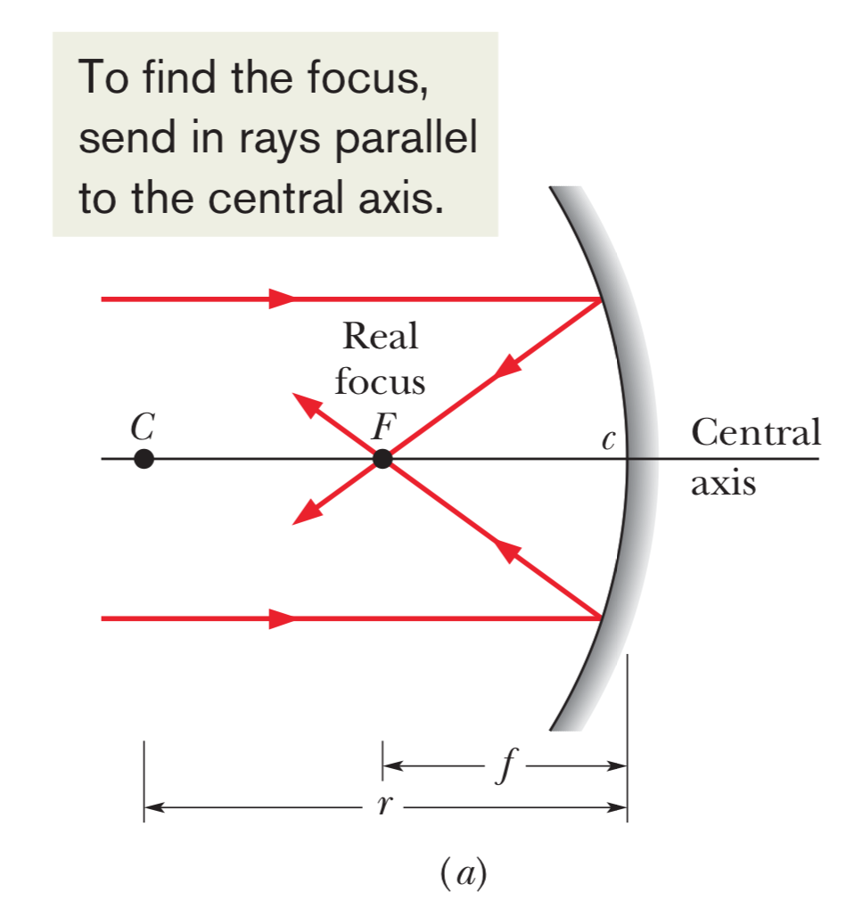
Focal point of a concave spherical mirror
Real focus point because actual light rays intersect

Slide 5
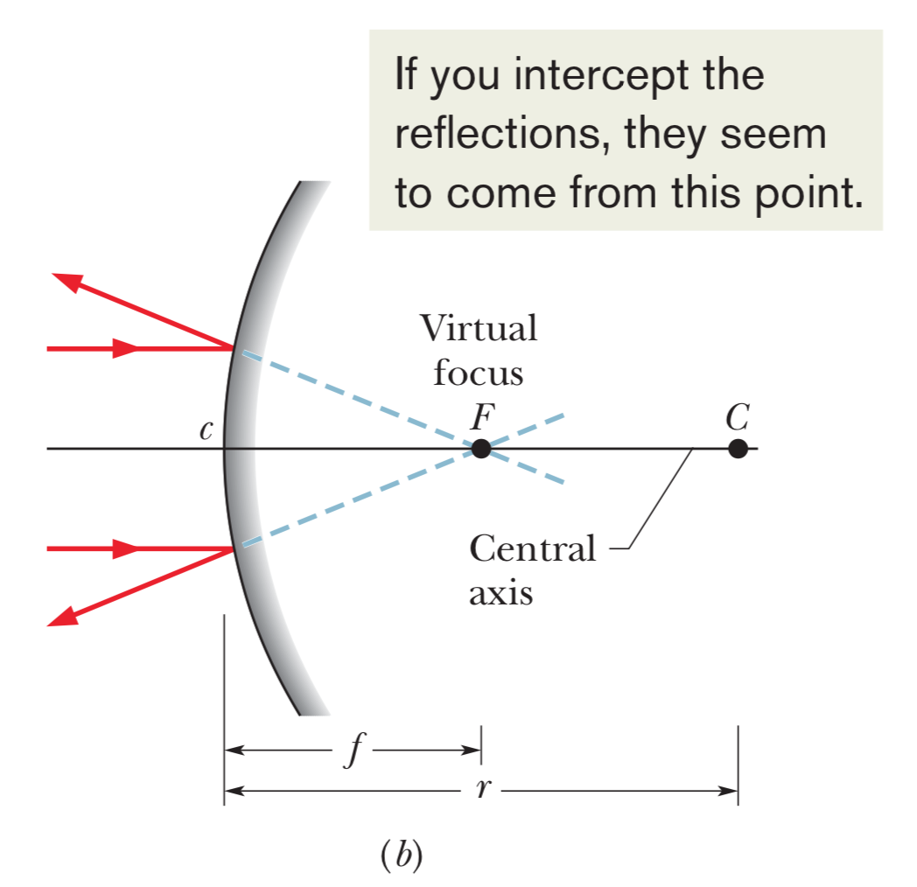
Focal point of a convex spherical mirror
Virtual focus point because actual light rays do not intersect

Slide 6
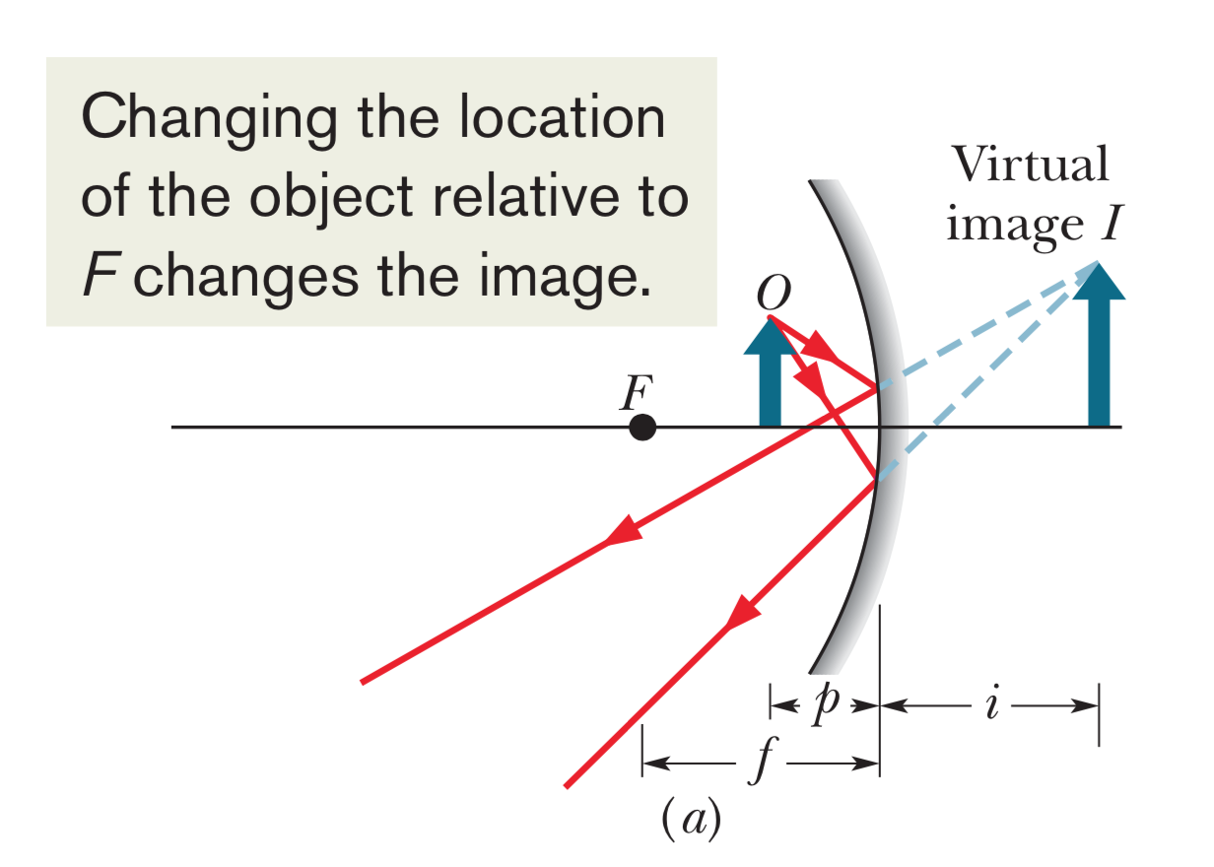
Image changes depending on object’s location

Slide 7
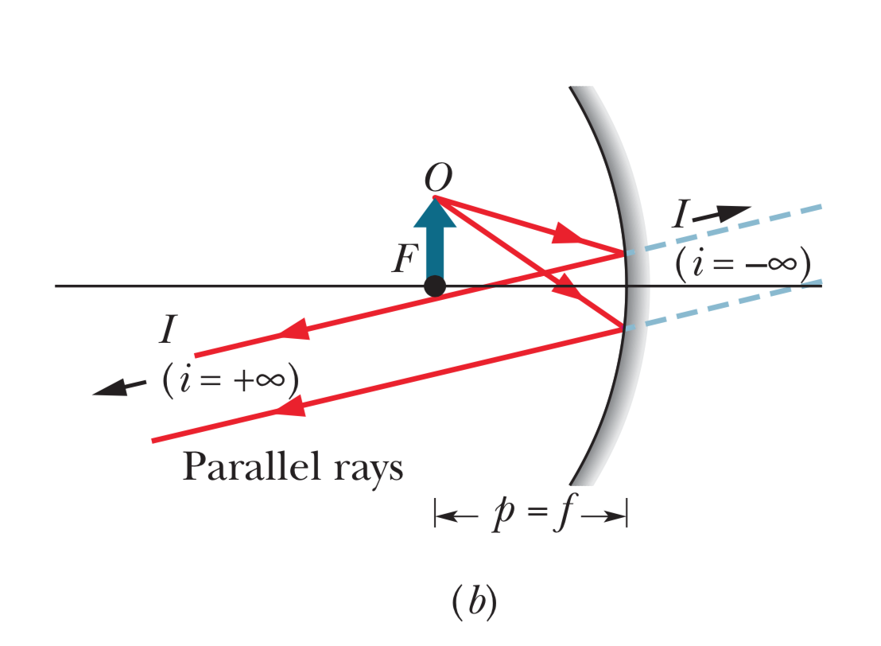

Slide 8
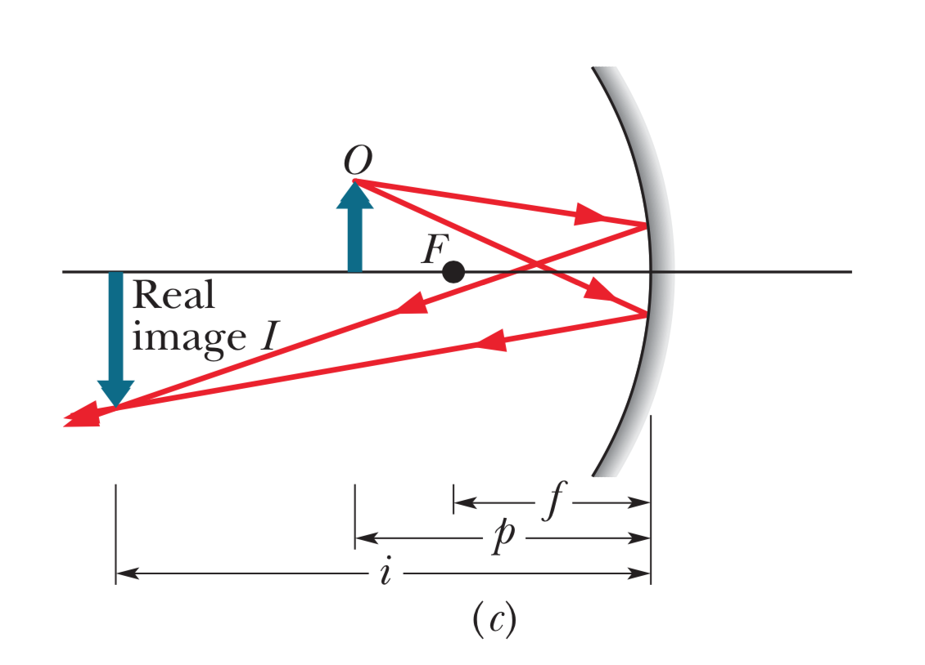

Slide 9
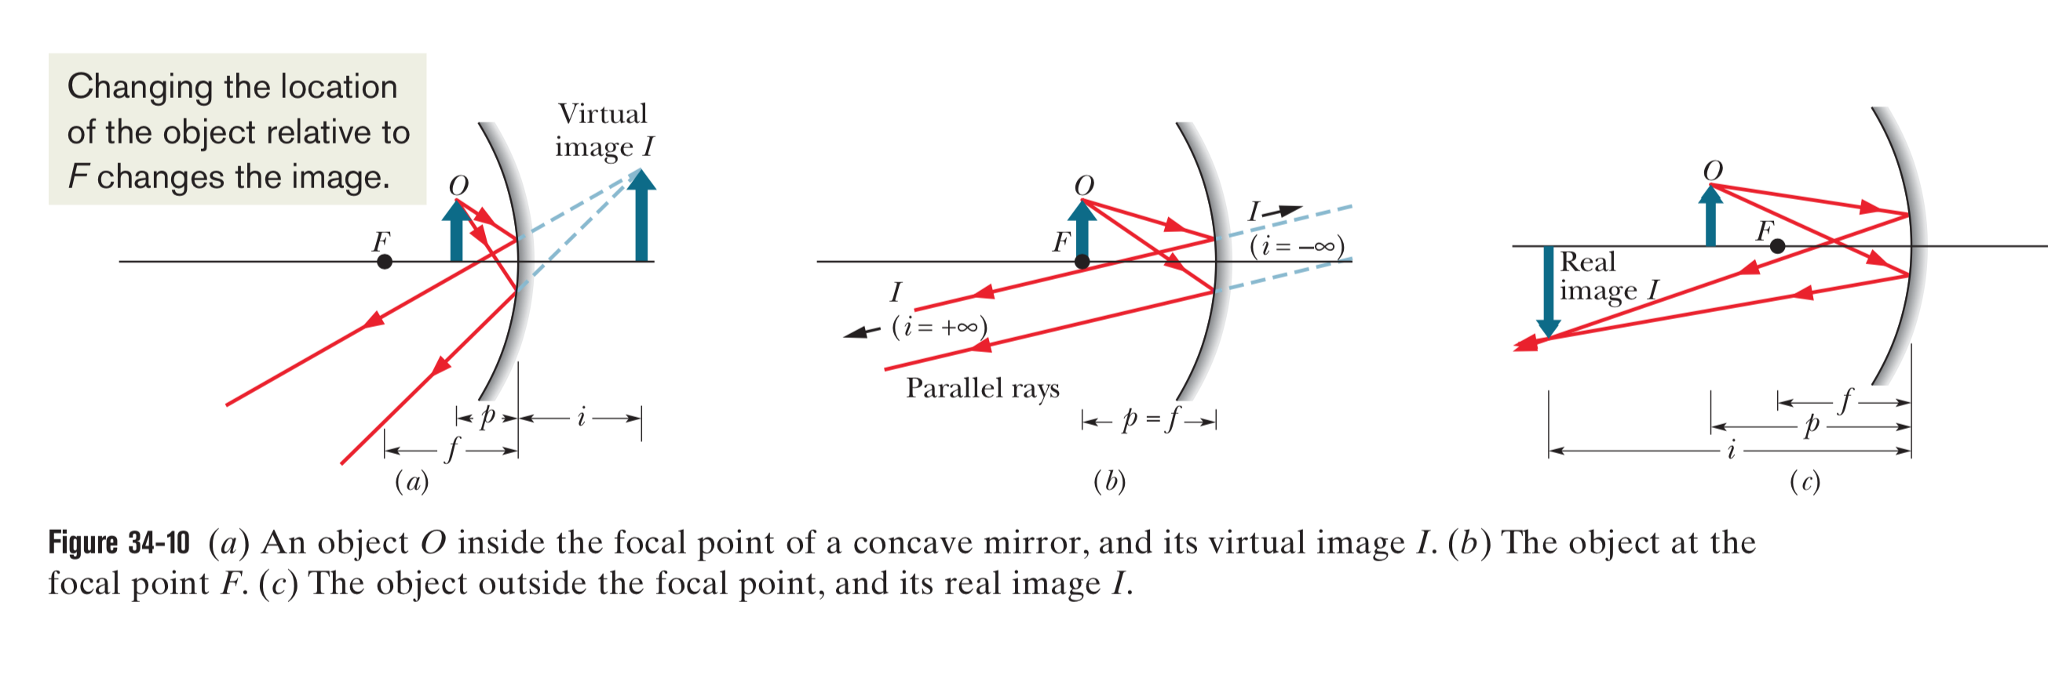

Slide 10
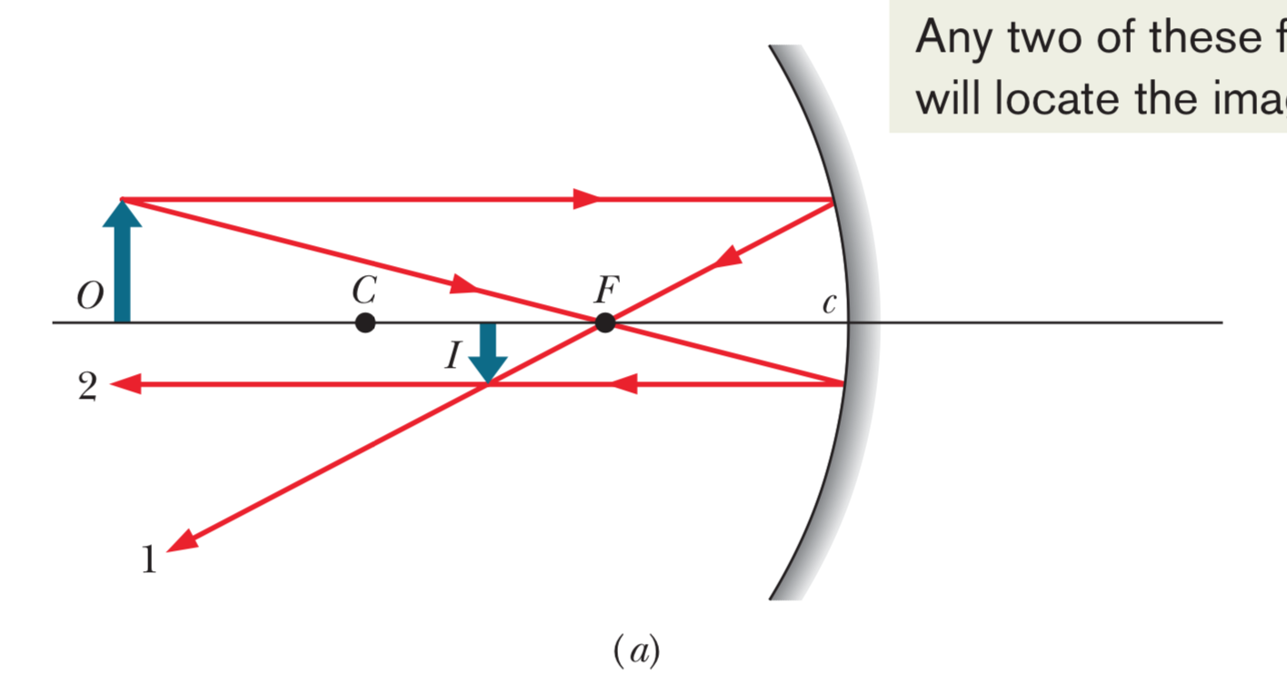
Locating an image (concave 1)

Slide 11
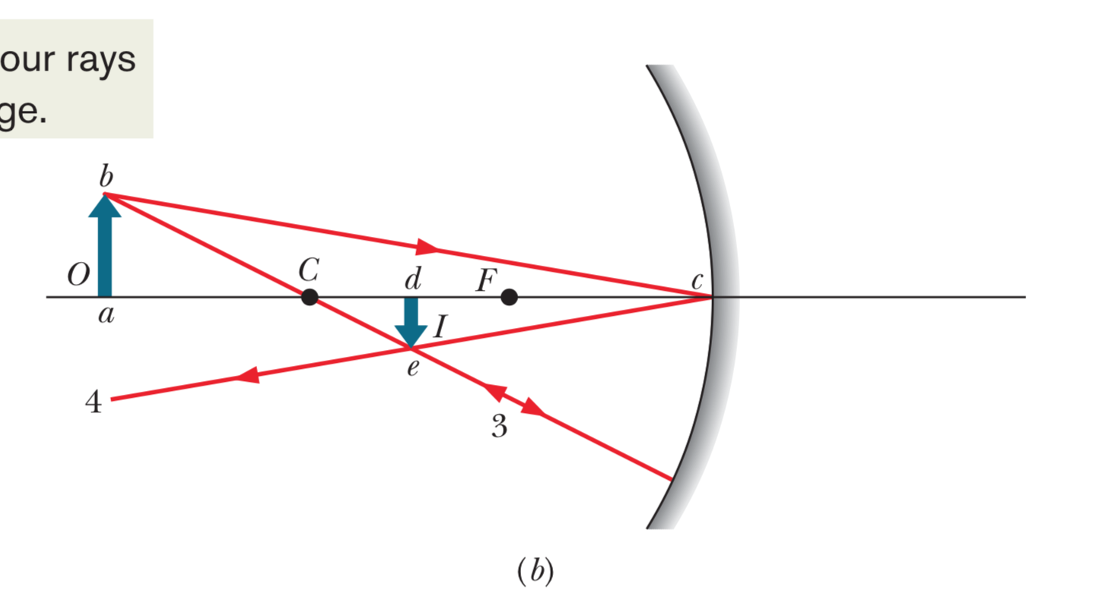
Locating an image (concave 2)

Slide 12
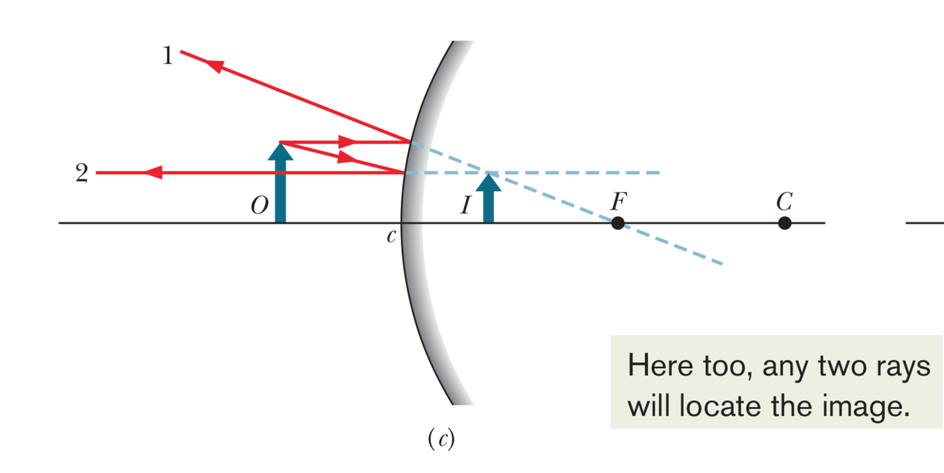
Locating an image (convex 1)

Slide 13
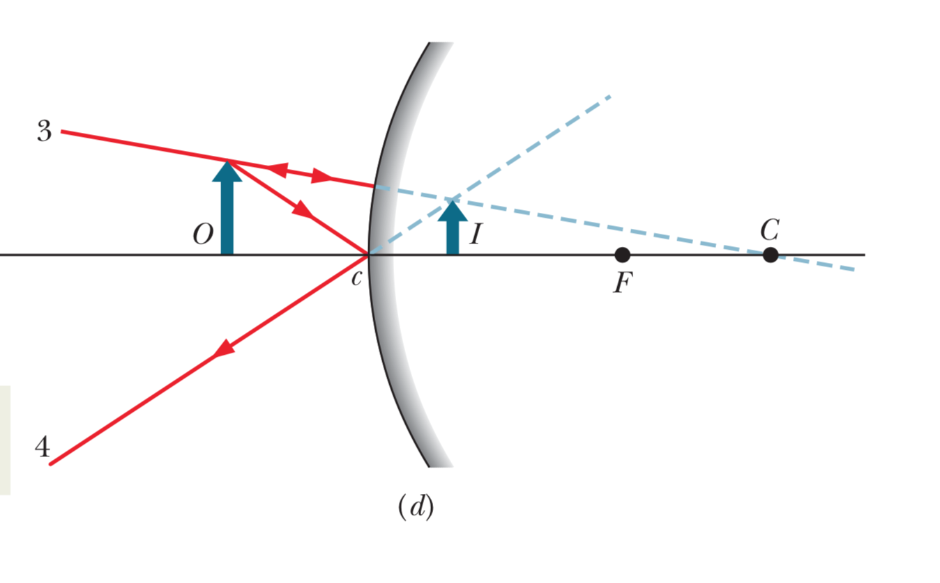
Locating an image (convex 2)

Slide 14
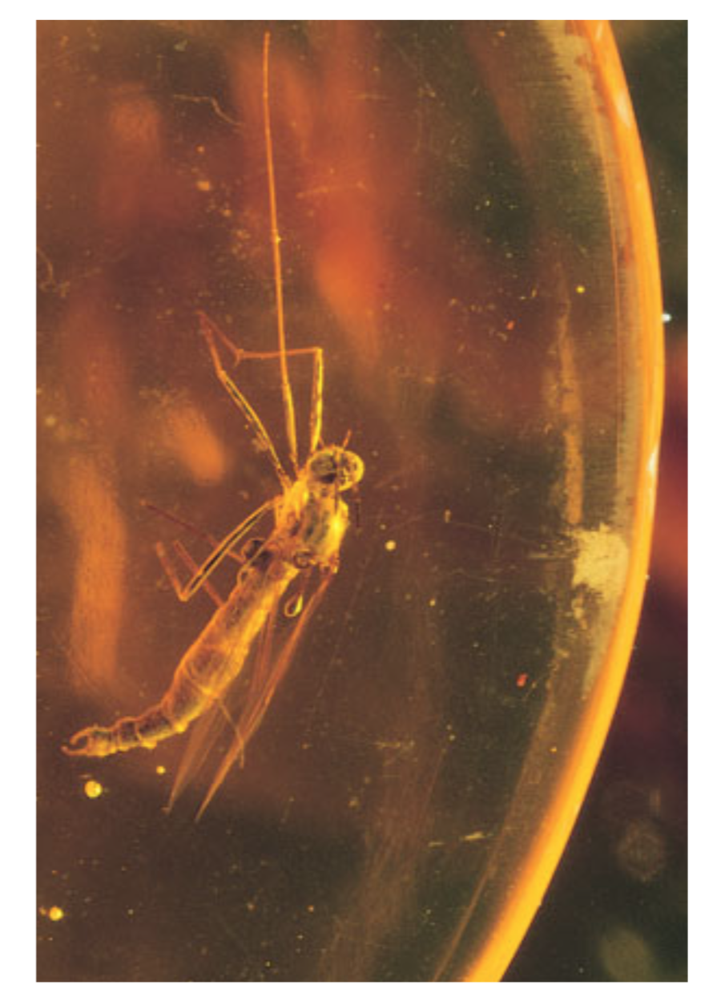
Refracting surfaces and images
Mosquito is not actually where it appears to be, due to refraction (similar situation in spearfishing)
Goal is to figure out relationship between physical distance and image distance

Slide 15
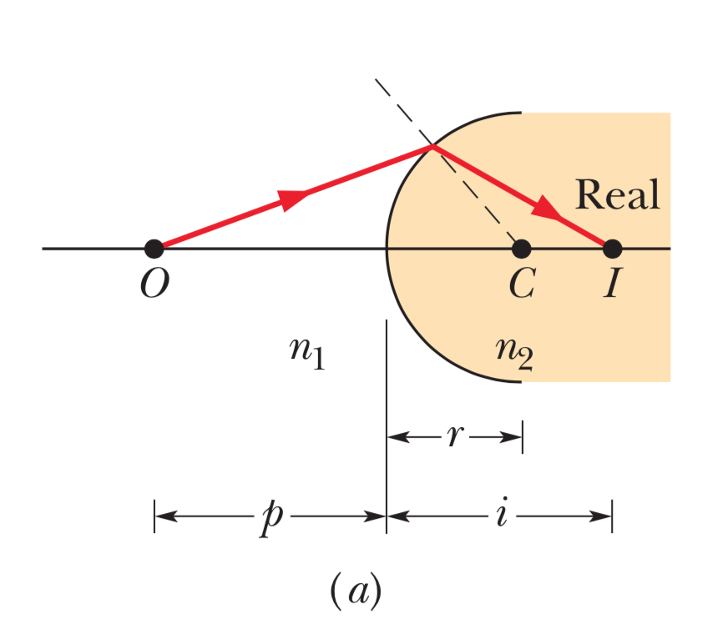
Spherical refracting surfaces (Example 1)
Shaded area corresponds to greater index of refraction

Slide 16
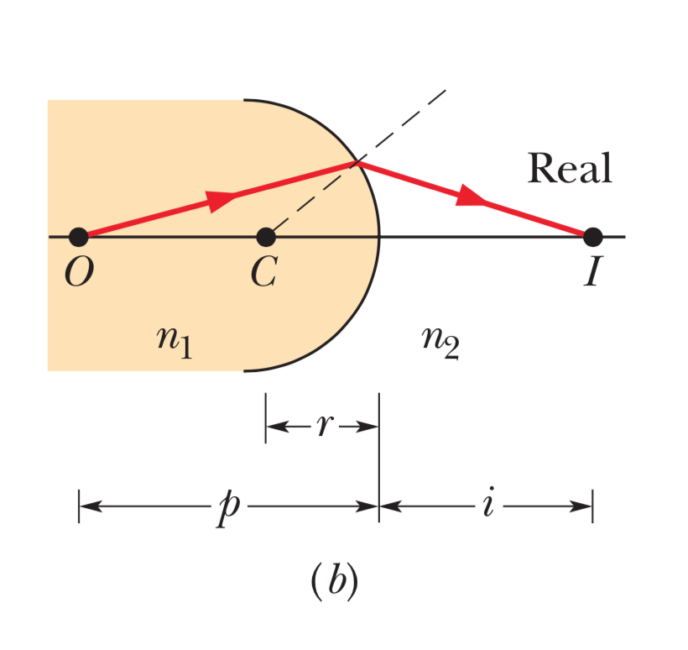
Spherical refracting surfaces (Example 2)

Slide 17
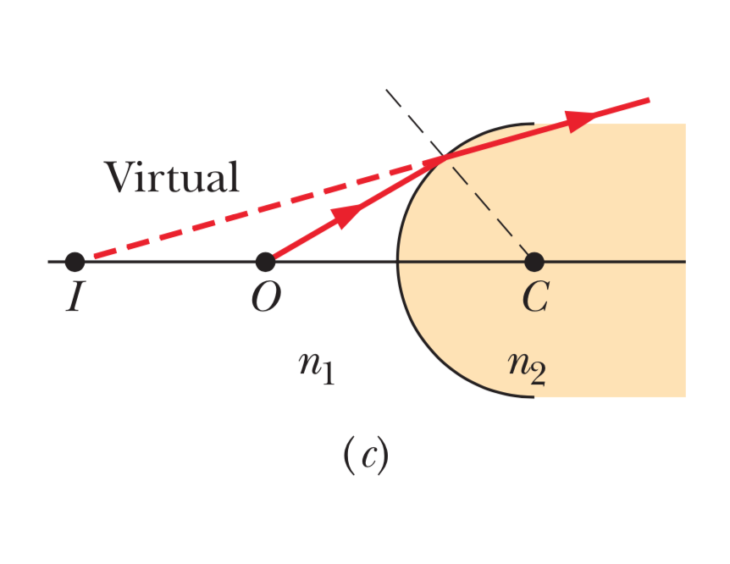
Spherical refracting surfaces (Example 3)

Slide 18
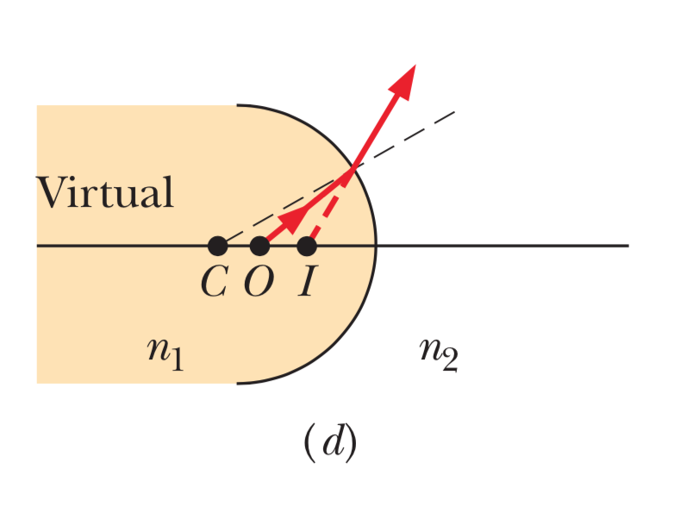
Spherical refracting surfaces (Example 4)

Slide 19
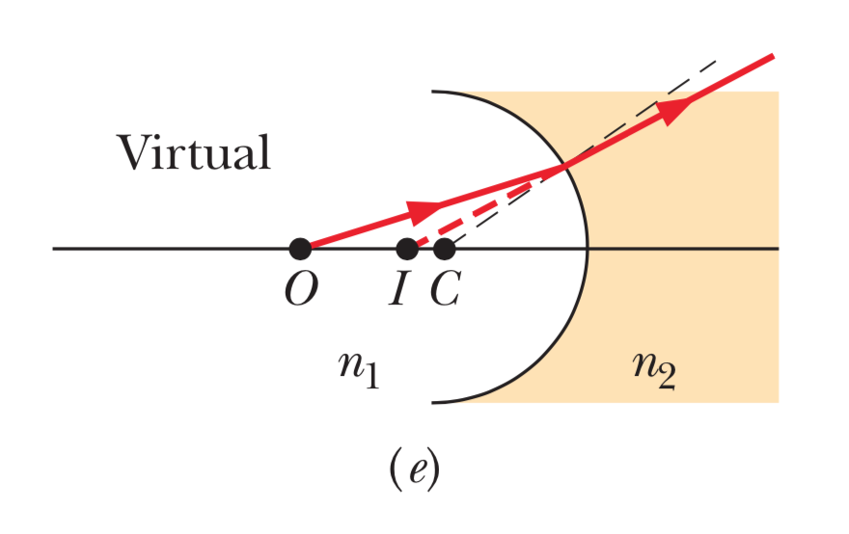
Spherical refracting surfaces (Example 5)

Slide 20
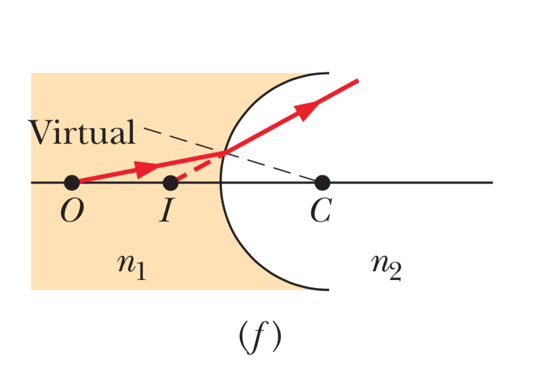
Spherical refracting surfaces (Example 6)

